Slide 1
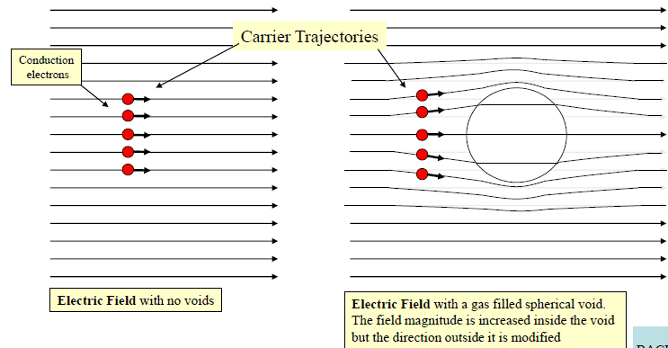
E-field distortion due to air cavity in insulation

Slide 2
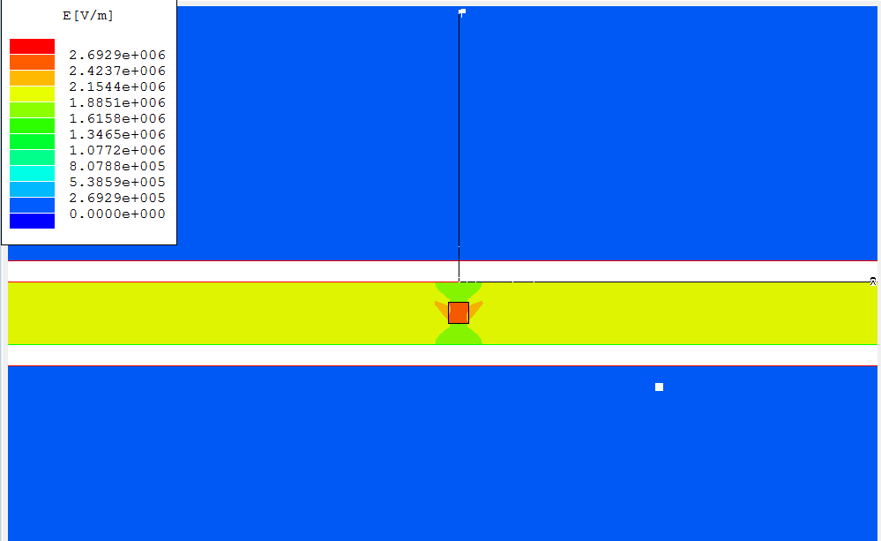
FEM -field enhancement in the embedded cavity

Slide 3
Electric field variations during PD activity

Slide 4
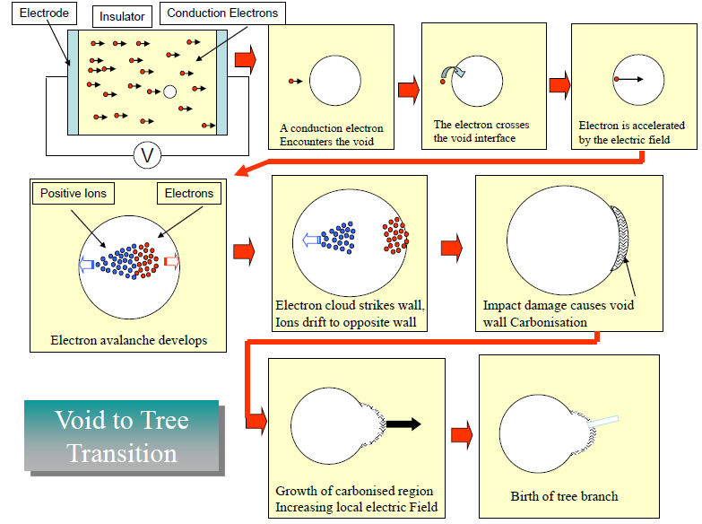
Partial discharge initiated failure mechanism

Slide 5
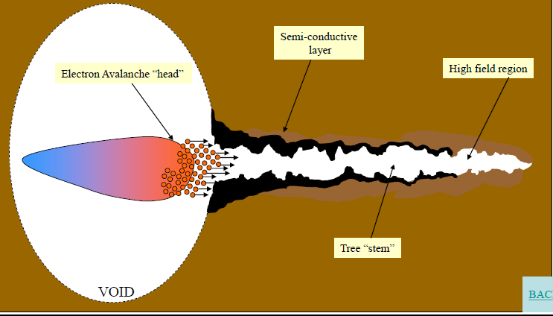
Tree grows from PD activity in a cavity

Slide 6
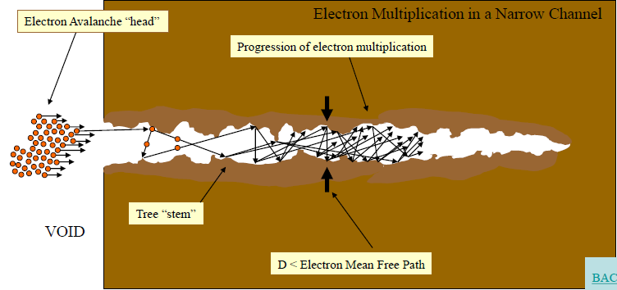
Electrical tree partial discharges

Slide 7
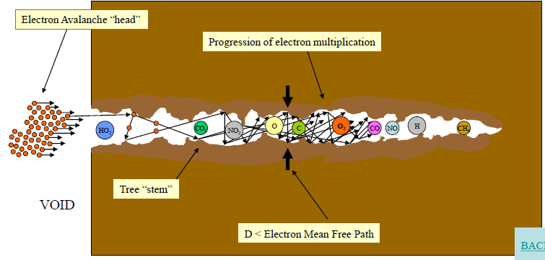
Physiochemical processes in the electrical tree channel

Slide 8
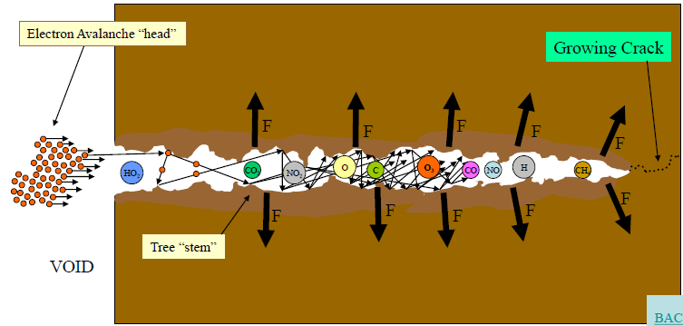
Tree progresses to complete insulation failure

